Slide 1

AmariShop
shop management system
BOOST UP YOUR BUSINESS WITH EASY MANAGEMENT TOOL

Slide 2
Analyzing Project Scenario
AmariShop is a super shop located in Tejgaon, Dhaka. We sell different types of products in different categories. We have some dedicated customers and we offer discounts to engage more customers. The price of the product doesn’t include vat considering that vat percentage may vary from product to product. We buy products from manufacturers or wholesalers and sell them.
The product types are Electronic Devices, Electronic Accessories, TV & Home Appliances, Health & Beauty, Baby products & Toys, Groceries, Home & Lifestyle, Women’s Fashion, Men’s Fashion, Watches & Accessories, and Sports.
The number/amount of products may vary from time to time. When products become unavailable and we try to connect with the wholesalers.
There are some salespeople/customer attendants, one operator, one cashier, and one security guard giving their service. For security purposes, we need to store their information. One’s monthly salary can be cut if he/she becomes absent in one day. We offer bonuses at Eid festivals to them.
The management of the workers and the products are getting difficult day by day as our business is growing. Therefore a management system would be very helpful. We have a plan to expand our business to an online e-commerce shop in the future.

Slide 3
Getting into Database Management
Possible Entity | Possible Relationship | Possible Attributes
1. Shop 2. Employee [Salespeople, 1 operator, 1 cashier, 1 security guard] 3. Customer 4. Product | Customer buy Products Shop has Employees | 1. Employee Employee_id Employee_name Employee_email Employee_phone Employee_salary Employee_bonus 2. Customer Customer_id Customer_name Customer_email 3. Product Product_id Product_price Product_discount Product_unit [kg/liter/unit] Product_category Product_available[Bool] 4. Shop shopID Shop_name Shop_owner Shop_address Shop_contact Shop_costing Shop_profit

Slide 4
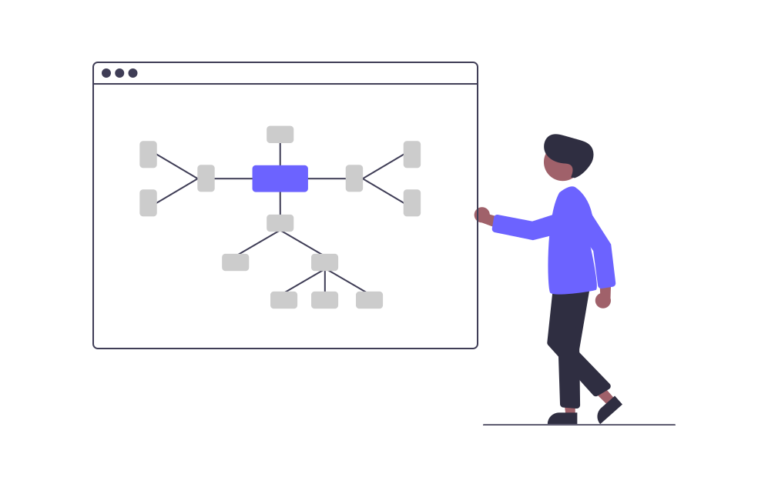

Slide 5
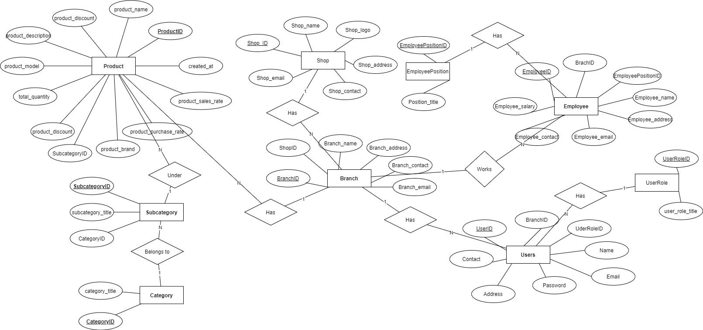
ER Diagram

Slide 6
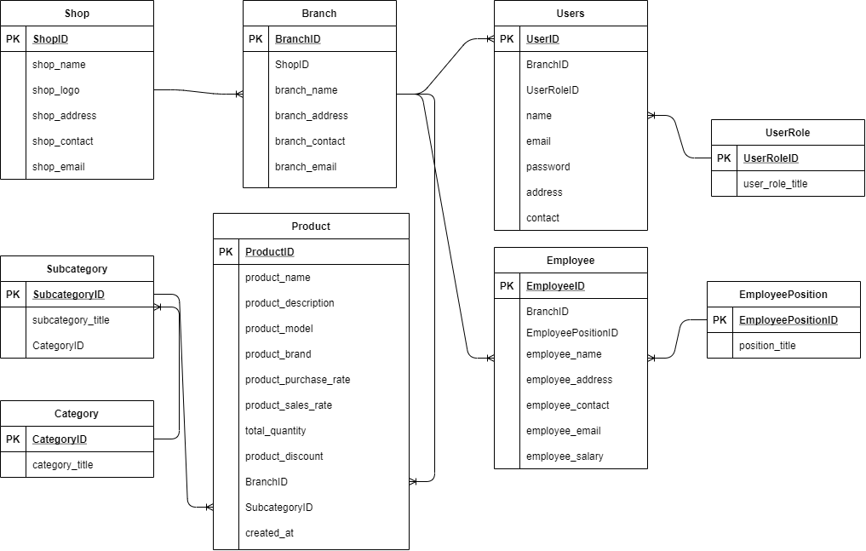
Relational Schema

Slide 7
KEY FEATURES
User Friendly interface & Easy to use
Excellent UI design
Your security is our main priority
Faster & Efficient Database Management with Microsoft SQL Server
And so on…

Slide 8
Thank You Very Much

